Slide 1

Smart Product Labeling and Traceability System
Simulated using Python

Slide 2
Introduction
Labeling is crucial for product tracking, compliance, and identification.
Manual labeling is error-prone.
This project simulates a smart, automated labeling system

Slide 3
Problem Statement
Design a system that:
Assigns serial numbers
Generates QR-coded labels
Verifies using OCR
Rejects incorrect labels
Logs all transactions

Slide 4
System Architecture
Inputs: Batch ID, GUI trigger
Processes : ID generation, label + QR creation, OCR verification
Outputs : Label image, pass/reject status, log file

Slide 5
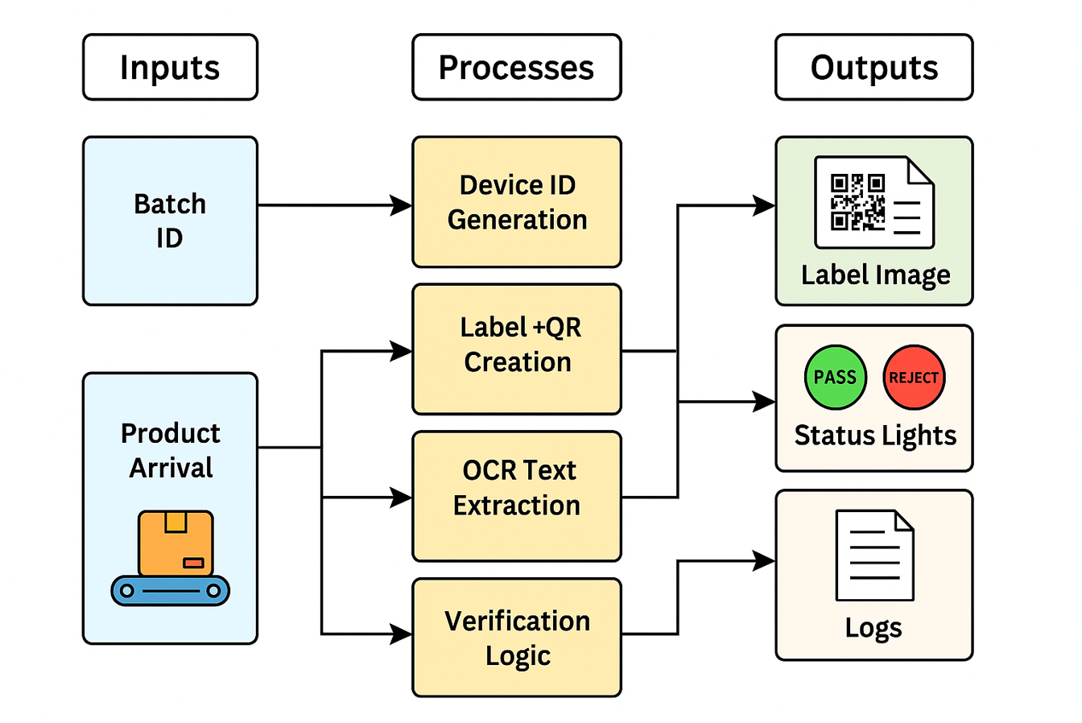
System Architecture

Slide 6
Technologies Used
Python 3.10+
Tkinter (GUI)
PIL (Image Creation)
qrcode (QR generation)
EasyOCR (Text detection)
CSV & JSON (Data logging)

Slide 7
GUI Workflow
1. Click "Simulate Detection"
2. Generate label and QR
3. OCR validation
4. Visual result (PASS/REJECT)
5. Log to CSV

Slide 8
Results
Handled multiple batches
-OCR handled distortions well
GUI feedback works as intended
Logs maintained successfully

Slide 9
Applications
Smart manufacturing
-Warehouse tracking
-Education/Training
Compliance systems

Slide 10
Advantages
Reduces human error
Real-time label validation
Easy to use GUI
Traceable logs
Cost-effective simulation

Slide 11
Conclusion
Modular, low-cost simulation
Demonstrates Industry 4.0 tools
Scalable to real hardware
Excellent for prototyping and learning

